Slide 1
Kubernetes Workshop: Develop and Deploy a Microservices Application on Kubernetes
Dell Technologies Educations Services

Slide 2
Workshop Agenda
DAY 2
Deploying containerized workloads on Kubernetes with pipeline
Logging and Monitoring
Persisting data in Kubernetes using PV & PVC

Slide 3
Build CI/CD Pipeline for your Containers
Notes:
3
01-08-2020

Slide 4
Release Process Stages
Source
Build
Test
Production
Check in source code
Get Peer review done
Compile code
Unit Tests
Style Checkers
Build and push container images
Integration Tests with other systems
Load Testing
UI Tests
Security Testing
Deployment to production
Environments
Monitor code in production
to quickly detect errors
Continuous Integration
Continuous Deployment

Slide 5

Release Process Stages
Source
Build
Test
Production
Check in source code
Get Peer review done
Compile code
Unit Tests
Style Checkers
Build and push container images
Integration Tests with other systems
Load Testing
UI Tests
Security Testing
Deployment to production Environments
Monitor code in production
to quickly detect errors
Continuous Integration
Continuous Delivery

Slide 6
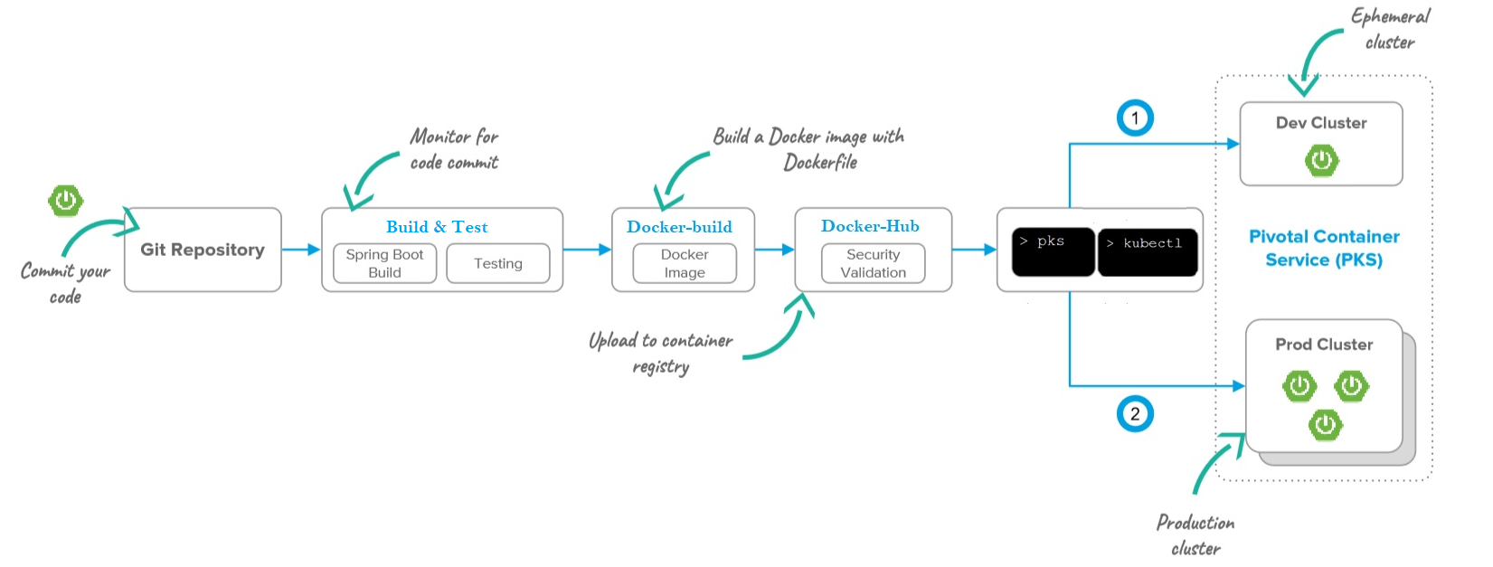

Continuous Deployment to PKS
Github Actions

Slide 7
Lab 5: Buid Pipeline with Github Actions

Slide 8
Kubernetes Logging and Monitoring

Slide 9
Different types of Logs presented by Kubernetes
Nodes
Pods
Containers
Control Plane
Notes:
9
01-08-2020

Slide 10
Logs presented by Nodes
kubectl describe node
System components logs (journalctl,syslog etc

Slide 11
kubectl log examples
kubectl logs -f # stream logs
kubectl logs --since=1h # return logs newer than a relative duration
kubectl logs --since-time=”??” # return logs after a specific date (RFC3339)
kubectl logs --previous # print the logs for the previous instance of the container
kubectl logs -c # print the logs of this container
kubectl logs -l # print logs from all containers in pods defined by label
kubectl get events --sort-by=’.metadata.creationTimestamp’ # print all events in chronological order
kubectl describe pod # print pod details like status or recent events

Slide 12
Logs presented by Control Plane
Pods
kubectl get events
System components logs (journalctl,syslog etc
Notes:
12
01-08-2020

Slide 13
Filtering kubectl get events results
$ kubectl get events --field-selector type=Warning
$ kubectl get events --field-selector involvedObject.kind=Pod
$ kubectl get events --field-selector involvedObject.kind=Node,involvedObject.name=minikube
$ kubectl get events --field-selector type!=Normal

Slide 14
kubectl top
Pods
kubectl top pod
kubectl top node
Notes:
14
01-08-2020

Slide 15
kubectl exec
Allows execution of arbitrary commands inside running containers
Can be used to call regular UNIX commands available inside the container(top,ps,tail,…
Allows interactive operations (exec –ti)

Slide 16
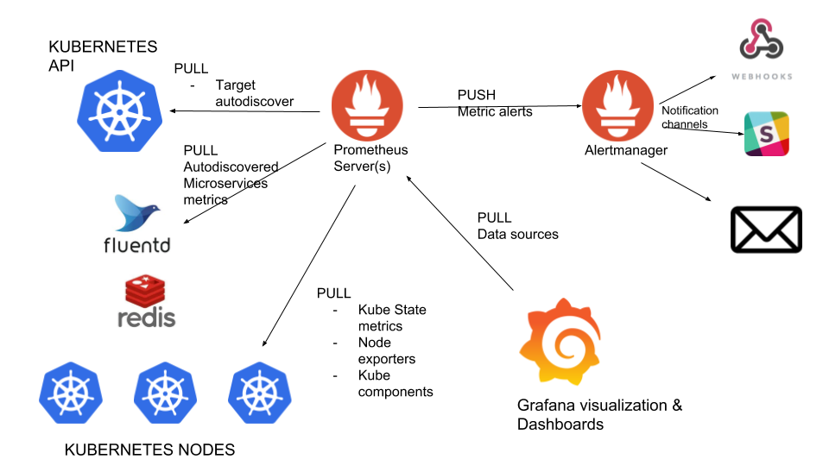
Kubernetes monitoring with Prometheus: Architecture overview

Slide 17
Lab 6: Kubernetes Logging and Monitoring

Slide 18
Data Persistence in Kubernetes

Slide 19
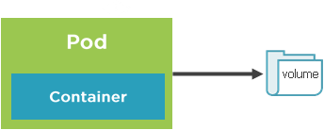
Storage Core Concepts
Pods live and die so their file system is short lived(ephemeral)
Volumes can be used to store state/data and use it in pod
A pod can have multiple volumes attached to it.
Containers rely on a mount path to access a volume
Kubernetes supports :
Volumes
PersistentVolumes
PersistentVolumesClaims
StorageClasses

Slide 20
Volumes and Volume mounts
A volume references a storage location
Must have a unique name
Attached to pod and may or may not be tied to the Pod’s lifetime
A volume mount references a volume by name and defines a mountPath

Slide 21
Volume type examples
emptyDir – Empty directory for storing “transient” data (shares a Pod’s lifetime) useful for sharing files between containers running in a Pod
nfs – A Network file system share mounted into the Pod
configMap/Secret – Special types of volumes that provide a Pod with access to Kubernetes resources
persistentVolumeClaim - Special types of volumes that provide a Pod with access to Kubernetes resources
Cloud – cluster wide storage

Slide 22
Volume Types
awsElasticBlockStore
azureDisk
azureFile
cephfs
configMap
csi
downwardAPI
emptyDir
fc (fibre channel)
flocker
gcePersistentDisk
gitRepo
glusterfs
hostPath
iscsi
local
nfs
persistentVolumeClaim
projected
portworxVolume
quobyte
rbd
scaleIO
secret
storageos
vsphereVolume

Slide 23
Defining an emptyDir Volume
apiVersion: v1
kind: Pod
spec:
volumes:
-name: html
emptyDir: {}
containers:
-name: nginx
image: nginx:alpine
volumeMounts:
-name: html
mountPath: /usr/share/nginx/html
readOnly: true
-name: html-updater
image: alpine
command: ["/bin/sh", "-c"]
args:
-while true; do date >> /html/index.html; sleep 10; done
volumeMounts:
-name: html
mountPath: /html
Define initial Volume named “html” that is an empty directory(lifetime of the Pod)
Reference “html” Volume and define a mountPath
Update file in Volume mount /html path with latest date every 10 seconds
Reference “html” Volume (defined above) and define a mountPath

Slide 24
Persistent volumes
A Persistent volume is cluster-wide storage resource that relies on network-attached storage(NAS)
Normally provisioned by cluster administrator
Available to a pod even if it gets rescheduled to a different node
Rely on a storage provider such as NFS, cloud storage, or other options
Associated with a Pod by using a PersistentVolumeClaim(PVC)

Slide 25
PersistentVolumeClaim
A PersistentVolumeClaim (PVC) is a request for storage unit.
Satisfies a set of requirements instead of mapping to a storage resource directly.
Ensures that an application’s ‘claim’ for storage is portable across numerous backends or providers.

Slide 26
PersistentVolume Workflow
Define a persistence volume(PV) and send to the Kubernetes API
Create a PersistentVolumeclaim(PVC)
Kubernetes binds the PVC to PV
Pod volume references the PVC
Create network storage resource(NFS ,Cloud etc.

Slide 27
Storage Class Core Concepts
A storage class is a type storage template that can be used to dynamically provision storage
Used to define different classes of storage
Act as a type of storage template
Supports dynamic provisioning of PersistentVolumes
Administrators need not create PVs in advance

Slide 28
Storage Class Workflow
Create a PersistentVolumeclaim(PVC) that references a Storage Class
Pod volume references the PVC
Bind to PVC
Kubernetes uses StorageClass provisioner to provision a PersistenceVolume
Create storage class

Slide 29
Secret Core Concepts
● A secret is an object that contains a small amount of sensitive data such as password, a token, or a key.
● Functionally identical to a ConfigMap.
● Stored as base64 encoded content.
● Encrypted at rest within etcd (if configured!).
● Stored on each worker node in tmpfs directory.
● Ideal for username/passwords, certificates or other sensitive information that should not be stored in a container.
● Pods can access secrets to secure which users can create Pods. Role-Based access control (RBAC) can be used.

Slide 30
Creating a Secret
Secrets can be created using kubectl create secret
# Create a new secret named my-secret with keys for each file in folder bar
$ kubectl create secret generic my-secret --from-file=path/to/bar
# Create a new secret named my-secret with specified keys instead of names on disk
$ kubectl create secret generic my-secret --from-file=ssh-privatekey=~/.ssh/id_rsa --from-file=ssh- publickey=~/.ssh/id_rsa.pub
# Create a new secret named my-secret with key1=supersecret and key2=topsecret
$ kubectl create secret generic my-secret --from-literal=key1=supersecret --from- literal=key2=topsecret

Slide 31
Defining a secret in yaml
type: There are three different types of secrets within Kubernetes:
docker-registry - credentials used to authenticate to a container registry
generic/Opaque - literal values from different sources
tls - a certificate based secret
data: Contains key-value pairs of base64 encoded content.
apiVersion: v1
kind: Secret
metadata:
name: manifest-secret
type: Opaque
data:
username: ZXhhbXBsZQ==
password: bXlwYXNzd29yZA==

Slide 32
Using Secrets
# Get secrets
$ kubectl get secrets
# Get YAML for specific secret
$ kubectl get secrets db passwords -o yaml

Slide 33
Accessing a Secret: Environment vars
Pods can access Secret values through environment variables
apiVersion: v1
kind: Secret
metadata:
name: db-passwords
type: Opaque
data:
db-password: cGFzc3dvcmQ=
admin-password: dmVyeV9zZWNy=
apiVersion: apps/v1
...
spec:
template:
...
spec:
containers: ...
env:
- name: DATABASE_PASSWORD
valueFrom:
secretKeyRef:
name: db-passwords
key: db-password

Slide 34
Lab 7 & 8: In memory & Data Persistence in Kubernetes

